Slide 1

Global Air Transportation Network

Slide 2
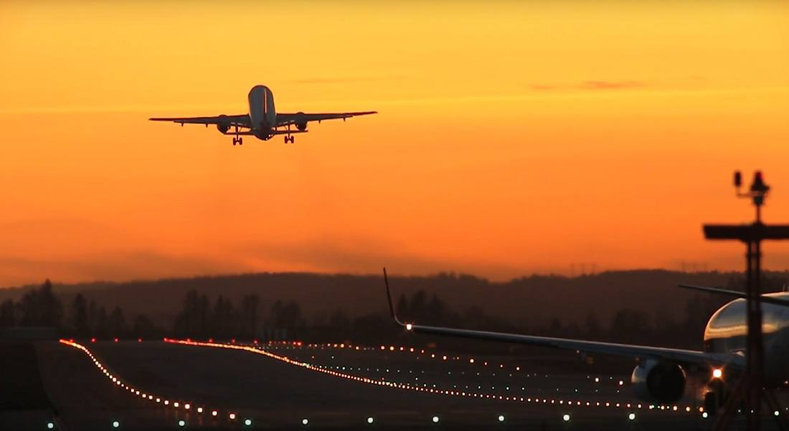
Long Term Internship
Unlocking Insights into The Global Air Transportation Network with Tableau

Slide 3

SREE VIDYANIKETHAN DEGREE COLLEGE
TEAM MEMBERS
1. R. SANDHYA
2. N. PRIYANKA
3. C.R. VINEELA
4. S. MAHAMMAD ARIF
5. B. HEMANTH
Guided By : Team ID:
DR. S. Asif Alisha LTVIP2023TMID10823
Ms. S. Vasiha Anjum

Slide 4

Project Contents
Data preparation
Data visualization
Dash board
Story
Performance testing
Web integration

Slide 5


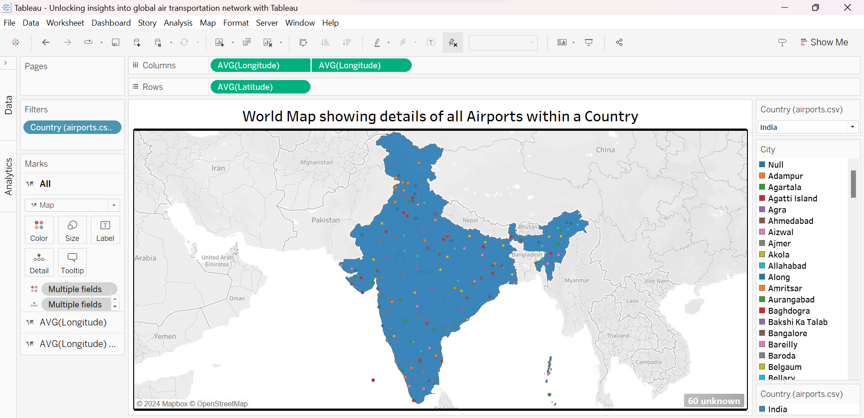
Data Visualisations

Slide 6
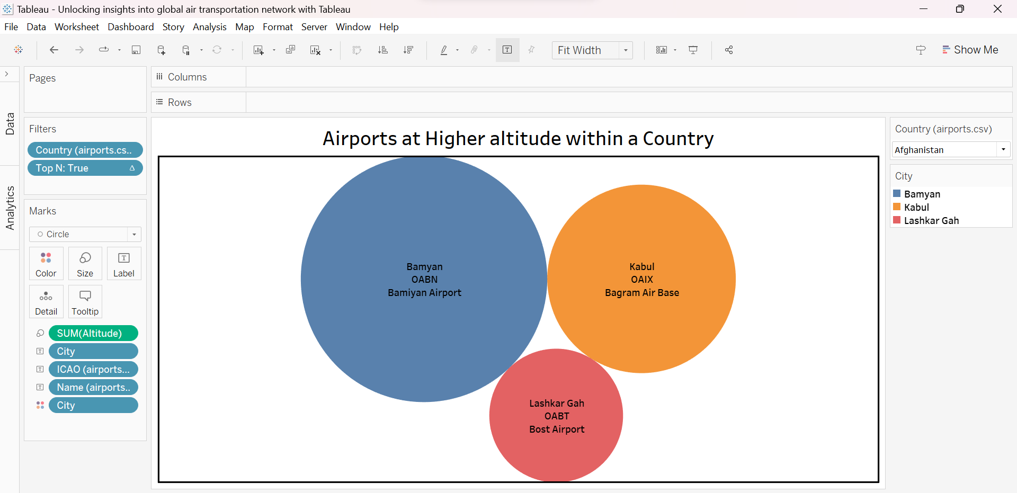

Slide 7
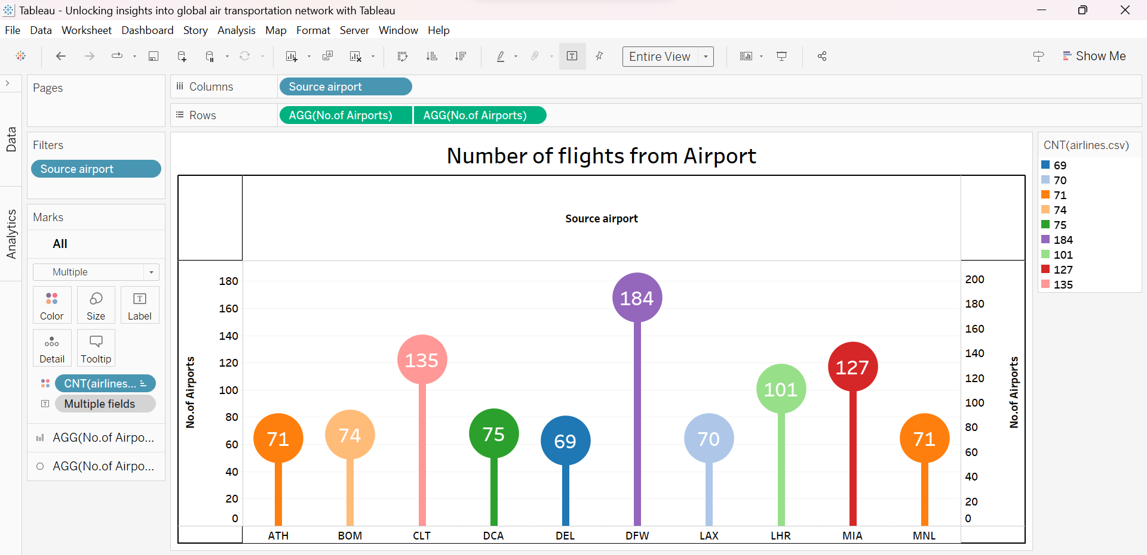

Slide 8
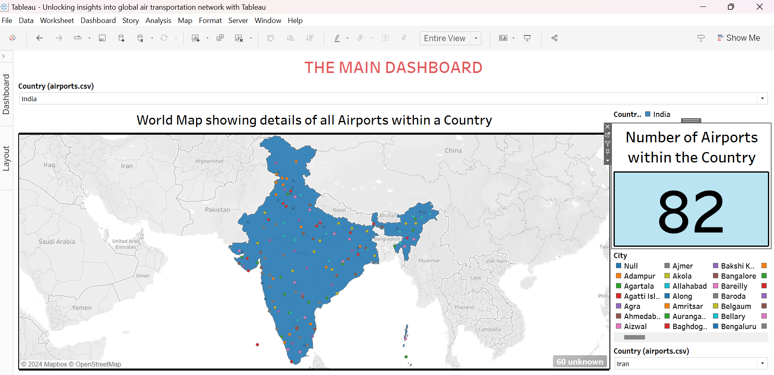
Dashboard

Slide 9
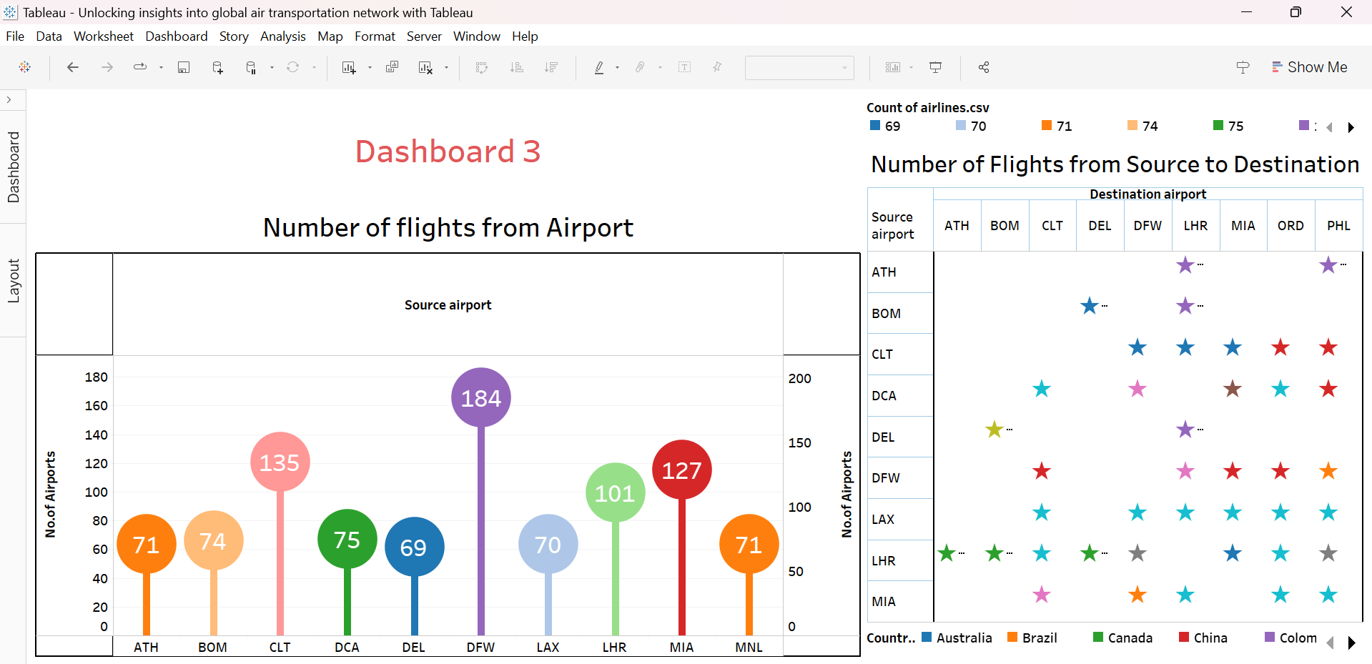

Slide 10
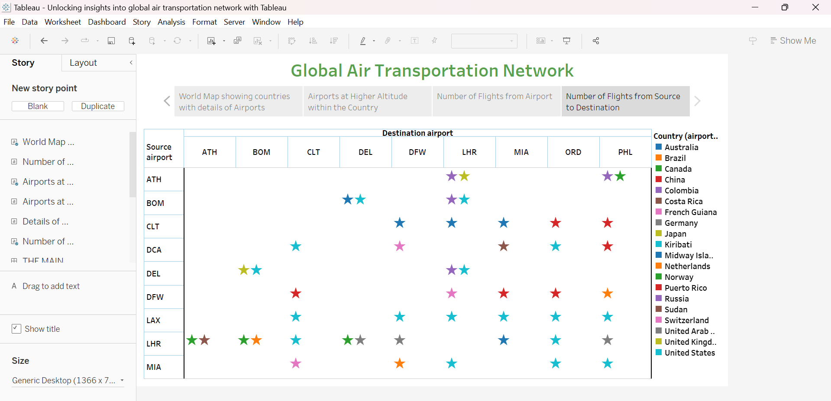
Story

Slide 11

Dashboards Link
https://public.tableau.com/views/UnlockinginsightsintoglobalairtransportationnetworkwithTableau/THEMAINDASHBOARD?:language=en-US&publish=yes&:sid=&:display_count=n&:origin=viz_share_link
https://public.tableau.com/views/UnlockinginsightsintoglobalairtransportationnetworkwithTableau1/Dashboard1?:language=en-US&publish=yes&:sid=&:display_count=n&:origin=viz_share_link
https://public.tableau.com/views/UnlockinginsightsintoglobalairtransportationnetworkwithTableau2/Dashboard2?:language=en-US&publish=yes&:sid=&:display_count=n&:origin=viz_share_link
https://public.tableau.com/views/UnlockinginsightsintoglobalairtransportationnetworkwithTableau3/Dashboard3?:language=en-US&publish=yes&:sid=&:display_count=n&:origin=viz_share_link

Slide 12

Story Link
https://public.tableau.com/shared/Q639MBY2Z?:display_count=n&:origin=viz_share_link

Slide 13

Web Integration Link
http://127.0.0.1:5000

Slide 14

STUDENT DETAILS
1. Name: Rayalla Sandhya 2. Name: N. Priyanka
Hall ticket no: 0322022131 Hall ticket no:0322022122
Admin no: BSCMSCS2021010 Admin no:BSCMSCS2021029
Email Id: rayallasandhya7@gmail.com Email Id: nellorepriyanka15@gmail.com
3. Name: C.R. Vineela 4.Name: S. Mahammad Arif
Hall ticket no: 0322022108 Hall ticket no: 0322022134
Admin no: BSCMSCS2021022 Admin no:BSCMSCS2021026
Email Id: vineela9014@gmail.com Email Id: sarifarif2003@gmail.com
5. Name : B. Hemanth
Hall ticket no : 0322022079
Admin no: BSCMSCS2021031
Email Id: bhemanth68@gmail.com

Slide 15

THANK YOU

